Slide 1
PMD Source Code Analyzer
Improving code quality

Slide 2
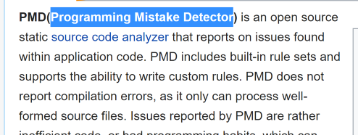
https://pmd.github.io/

Slide 3
Setup
Download and unzip
Optionally add the bin subdirectory in your PATH
Requires JRE 1.7 or higher

Slide 4
Execution
Directory for classes to be analyzed
Format of report, text or XML
Ruleset path
[Redirect output to file]
pmd -d C:\Users\...\classes -f text
-R C:\Users\...\rulesets\apex\ruleset.xml
[> C:\Users\...\ApexPMDoutput.txt]

Slide 5
Examples
pmd -d C:\Users\...\force-app\main\default\classes -f text -R C:\Users\...\rulesets\apex\ruleset.xml\StdCyclomaticComplexity
pmd -d C:\Users\...\force-app\main\default\classes -f text -R C:\Users\...\rulesets\apex\style.xml

